Slide 1
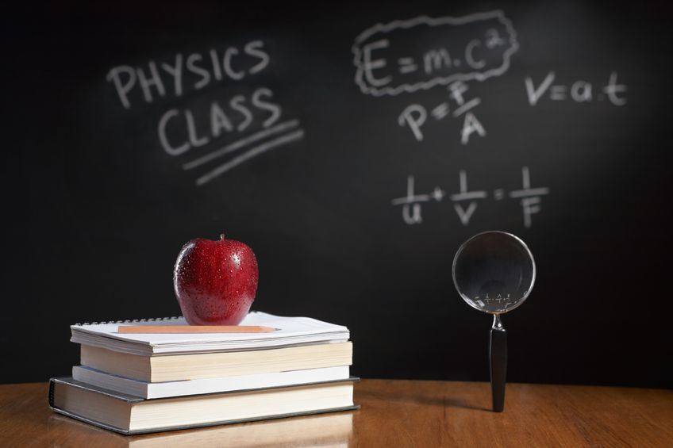
PHYSICS – Length and Time

Slide 2
LEARNING OBJECTIVES
1.1 Length and time Core • Use and describe the use of rules and measuring cylinders to find a length or a volume • Use and describe the use of clocks and devices, both analogue and digital, for measuring an interval of time • Obtain an average value for a small distance and for a short interval of time by measuring multiples (including the period of a pendulum). | Supplement • Understand that a micrometer screw gauge is used to measure very small distances

Slide 3
SI units

Slide 4
SI units
(Le Systeme International d’Unites)

Slide 5
SI units
(Le Systeme International d’Unites)
Mass → kilogram

Slide 6
SI units
(Le Systeme International d’Unites)
Mass → kilogram
Time → second

Slide 7
SI units
(Le Systeme International d’Unites)
Mass → kilogram
Time → second
Length → metre

Slide 8
SI units
1 tonne = 1000kg = 10³kg
(Le Systeme International d’Unites)
Mass → kilogram
kg
Time → second
Length → metre

Slide 9
SI units
1 tonne = 1000kg = 10³kg
(Le Systeme International d’Unites)
Mass → kilogram
kg
1 kilogram (1kg)
Time → second
Length → metre

Slide 10
SI units
1 tonne = 1000kg = 10³kg
(Le Systeme International d’Unites)
Mass → kilogram
kg
1 kilogram (1kg)
Time → second
1 gram (g) = 1/1000kg = 10⁻³kg
Length → metre

Slide 11
SI units
1 tonne = 1000kg = 10³kg
(Le Systeme International d’Unites)
Mass → kilogram
kg
1 kilogram (1kg)
Time → second
1 gram (g) = 1/1000kg = 10⁻³kg
Length → metre
1 milligram (mg) = 1/1 000g = 1/1 000 000kg = 10⁻⁶kg

Slide 12
SI units
(Le Systeme International d’Unites)
Mass → kilogram
Time → second
s
Length → metre

Slide 13
SI units
1 millisecond (ms)
= 1/1000s = 10⁻³s
(Le Systeme International d’Unites)
Mass → kilogram
Time → second
s
Length → metre

Slide 14
SI units
1 millisecond (ms)
= 1/1000s = 10⁻³s
(Le Systeme International d’Unites)
Mass → kilogram
1 microsecond (µs)
= 1/1 000 000s = 10⁻⁶s
Time → second
s
Length → metre

Slide 15
SI units
1 millisecond (ms)
= 1/1000s = 10⁻³s
(Le Systeme International d’Unites)
Mass → kilogram
1 microsecond (µs)
= 1/1 000 000s = 10⁻⁶s
Time → second
s
1 nanosecond (ns)
= 1/1 000 000 000s = 10⁻⁹s
Length → metre

Slide 16
SI units
(Le Systeme International d’Unites)
1 metre (m)
Mass → kilogram
Time → second
Length → metre
m

Slide 17
SI units
1 kilometre (km) = 1 000m = 10³m
(Le Systeme International d’Unites)
1 metre (m)
Mass → kilogram
Time → second
Length → metre
m

Slide 18
SI units
1 kilometre (km) = 1 000m = 10³m
(Le Systeme International d’Unites)
1 metre (m)
Mass → kilogram
1 centimetre (cm) = 1/100m = 10⁻²m
Time → second
Length → metre
m

Slide 19
SI units
1 kilometre (km) = 1 000m = 10³m
(Le Systeme International d’Unites)
1 metre (m)
Mass → kilogram
1 centimetre (cm) = 1/100m = 10⁻²m
1 millimetre (cm) = 1/1000m = 10⁻³m
Time → second
Length → metre
m

Slide 20
SI units
1 kilometre (km) = 1 000m = 10³m
(Le Systeme International d’Unites)
1 metre (m)
Mass → kilogram
1 centimetre (cm) = 1/100m = 10⁻²m
1 millimetre (mm) = 1/1000m = 10⁻³m
Time → second
1 micrometre (µm) = 1/1 000 000m = 10⁻⁶m
Length → metre
m

Slide 21
SI units
1 kilometre (km) = 1 000m = 10³m
(Le Systeme International d’Unites)
1 metre (m)
Mass → kilogram
1 centimetre (cm) = 1/100m = 10⁻²m
1 millimetre (mm) = 1/1000m = 10⁻³m
Time → second
1 micrometre (µm) = 1/1 000 000m = 10⁻⁶m
Length → metre
m
1 nanometre (nm) = 1/1 000 000 000m = 10⁻⁹m

Slide 22
OK, so you think you’ve got all this ‘unit’ stuff? What units would be most suitable for the following?
SI units
(Le Systeme International d’Unites)

Slide 23
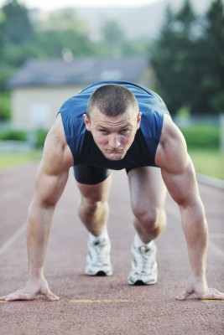
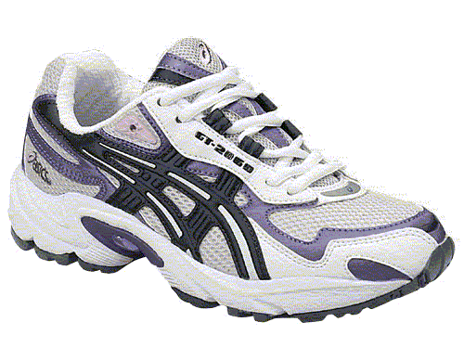
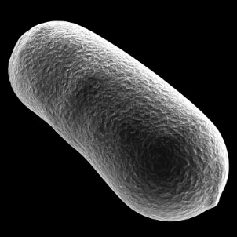
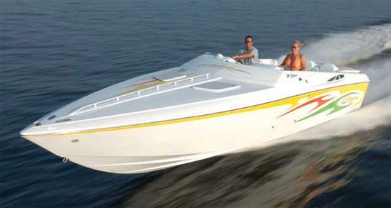
OK, so you think you’ve got all this ‘unit’ stuff? What units would be most suitable for the following?
SI units
(Le Systeme International d’Unites)
The mass of a shoe =
Time for an athlete to race =
The length of a bacterium =
The mass of a boat =

Slide 24
OK, so you think you’ve got all this ‘unit’ stuff? What units would be most suitable for the following?
SI units
(Le Systeme International d’Unites)
The mass of a shoe =
kilogram
Time for an athlete to race =
second
The length of a bacterium =
micrometre
The mass of a boat =
tonne

Slide 25
Let’s have a think now about what we might use to measure length and time.
Measuring

Slide 26
Let’s have a think now about what we might use to measure length and time.
Measuring
LENGTH

Slide 27
Let’s have a think now about what we might use to measure length and time.
Measuring
LENGTH
Ruler

Slide 28
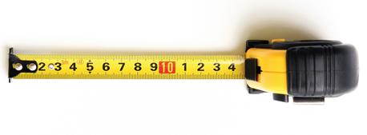
Let’s have a think now about what we might use to measure length and time.
Measuring
LENGTH
Tape measure

Slide 29
Let’s have a think now about what we might use to measure length and time.
Measuring
LENGTH
Calipers

Slide 30
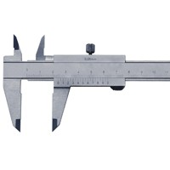
Let’s have a think now about what we might use to measure length and time.
Measuring
LENGTH
Vernier Calipers

Slide 31
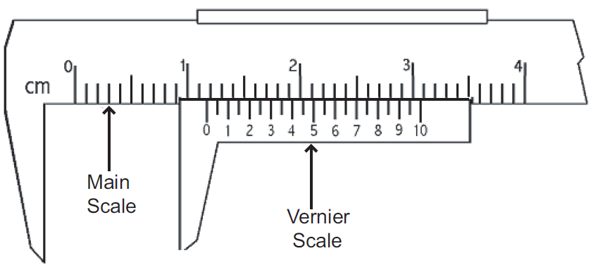
Let’s have a think now about what we might use to measure length and time.
Measuring
LENGTH
Vernier Calipers
Measurement using the Vernier scale = 1.76cm
Gap being measured

Slide 32
Let’s have a think now about what we might use to measure length and time.
Measuring
TIME

Slide 33
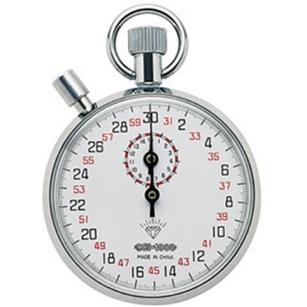
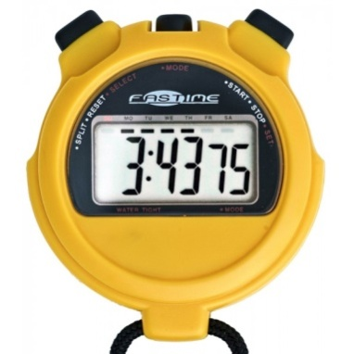
Let’s have a think now about what we might use to measure length and time.
Measuring
TIME
Stopwatch
Analogue
Digital

Slide 34
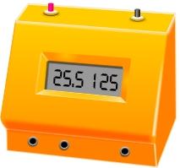
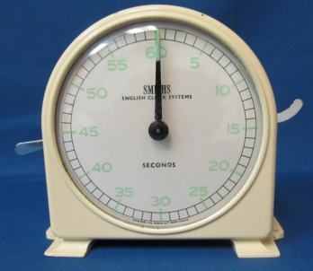
Let’s have a think now about what we might use to measure length and time.
Measuring
TIME
Stopwatch
Stopclock
Analogue
Digital
Analogue
Digital

Slide 35
Let’s have a think now about what we might use to measure length and time.
Measuring
TIME
Measuring a pendulum swing
B
C
A

Slide 36
Let’s have a think now about what we might use to measure length and time.
Measuring
TIME
Measuring a pendulum swing
One complete swing =
A → B → A → C → A
B
C
A

Slide 37
Let’s have a think now about what we might use to measure length and time.
Measuring
TIME
Measuring a pendulum swing
How can we measure the time taken for one complete swing of the pendulum (= Period)?
One complete swing =
A → B → A → C → A
B
C
A

Slide 38
Let’s have a think now about what we might use to measure length and time.
Measuring
TIME
Measuring a pendulum swing
How can we measure the time taken for one complete swing of the pendulum (= Period)?
One complete swing =
A → B → A → C → A
Measure the time for 25 swings and divide the result by 25
B
C
A

Slide 39
Let’s have a think now about what we might use to measure length and time.
Measuring
TIME
Measuring a pendulum swing
How can we measure the time taken for one complete swing of the pendulum (= Period)?
One complete swing =
A → B → A → C → A
Measure the time for 25 swings and divide the result by 25
Eg. Time for 25 swings = 46 seconds.
Time for 1 swing = 46/25 = 1.84 seconds
B
C
A

Slide 40
LEARNING OBJECTIVES
1.1 Length and time Core • Use and describe the use of rules and measuring cylinders to find a length or a volume • Use and describe the use of clocks and devices, both analogue and digital, for measuring an interval of time • Obtain an average value for a small distance and for a short interval of time by measuring multiples (including the period of a pendulum). | Supplement • Understand that a micrometer screw gauge is used to measure very small distances

Slide 41
PHYSICS – Length and Time

