Slide 1
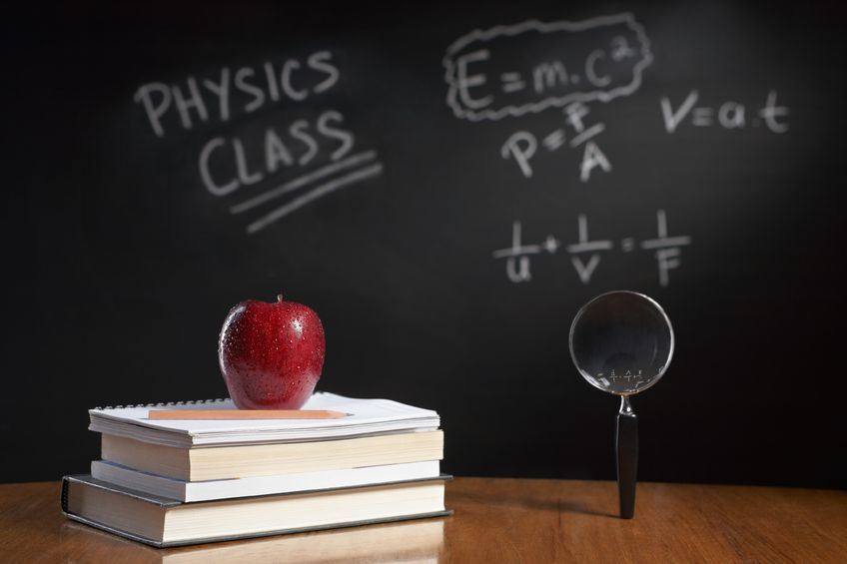
PHYSICS – Thermal processes

Slide 2
LEARNING OBJECTIVES
2.3.1 Conduction Core • Describe experiments to demonstrate the properties of good and bad thermal conductors 2.3.2 Convection Core • Recognise convection as an important method of thermal transfer in fluids • Relate convection in fluids to density changes and describe experiments to illustrate convection 2.3.3 Radiation Core • Identify infra-red radiation as part of the electromagnetic spectrum • Recognise that thermal energy transfer by radiation does not require a medium • Describe the effect of surface colour (black or white) and texture (dull or shiny) on the emission, absorption and reflection of radiation 2.3.4 Consequences of energy transfer Core • Identify and explain some of the everyday applications and consequences of conduction, convection and radiation | Supplement • Give a simple molecular account of conduction in solids including lattice vibration and transfer by electrons Supplement • Describe experiments to show the properties of good and bad emitters and good and bad absorbers of infra-red radiation • Show understanding that the amount of radiation emitted also depends on the surface temperature and surface area of a body

Slide 3
Thermal exchange

Slide 4
Thermal exchange
Conduction

Slide 5
Thermal exchange
Conduction
Convection

Slide 6
Thermal exchange
Conduction
Convection
Radiation

Slide 7
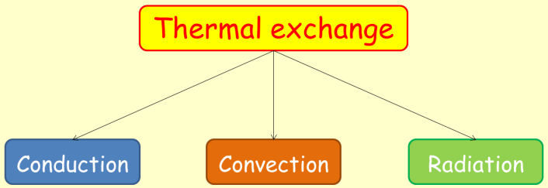
Thermal conduction

Slide 8
Thermal conduction
Metal bar
According to kinetic theory, all materials are made up of tiny, moving particles. In a solid these particles tend to vibrate around a fixed spot.

Slide 9
Thermal conduction
Metal bar
According to kinetic theory, all materials are made up of tiny, moving particles. In a solid these particles tend to vibrate around a fixed spot.
Heat

Slide 10
Thermal conduction
Metal bar
As the bar is heated, the particles tend to vibrate more.
Heat

Slide 11
Thermal conduction
Metal bar
As the bar is heated, the particles tend to vibrate more.
Thermal energy is transferred from the hot end to the cold end as the particles pass on their increased kinetic energy to other particles along the bar.
Heat

Slide 12
Thermal conduction
Thermal energy transfer is increased if:
1. Temperature difference across ends of bar is increased.
Metal bar
Thermal energy transferred by conduction
As the bar is heated, the particles tend to vibrate more.
Thermal energy is transferred from the hot end to the cold end as the particles pass on their increased kinetic energy to other particles along the bar.
Heat

Slide 13
Thermal conduction
Thermal energy transfer is increased if:
1. Temperature difference across ends of bar is increased.
Metal bar
Thermal energy transferred by conduction
As the bar is heated, the particles tend to vibrate more.
Thermal energy is transferred from the hot end to the cold end as the particles pass on their increased kinetic energy to other particles along the bar.
2. Cross-sectional area of the bar is increased.
Heat

Slide 14
Thermal conduction
Thermal energy transfer is increased if:
1. Temperature difference across ends of bar is increased.
Metal bar
Thermal energy transferred by conduction
As the bar is heated, the particles tend to vibrate more.
Thermal energy is transferred from the hot end to the cold end as the particles pass on their increased kinetic energy to other particles along the bar.
2. Cross-sectional area of the bar is increased.
3. The length of the bar is reduced.
Heat

Slide 15
Thermal conduction
Conductors and insulators

Slide 16
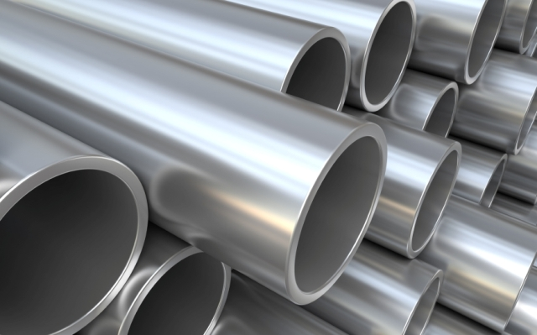
Thermal conduction
Conductors and insulators
Metals are the best thermal conductors. They feel cold to the touch as heat is quickly conducted away from your hand.

Slide 17
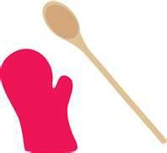
Thermal conduction
Conductors and insulators
Metals are the best thermal conductors. They feel cold to the touch as heat is quickly conducted away from your hand.
Non-metals tend to be poor conductors. A polystyrene tile feels warm to the touch because it stops your hand from losing thermal energy.

Slide 18
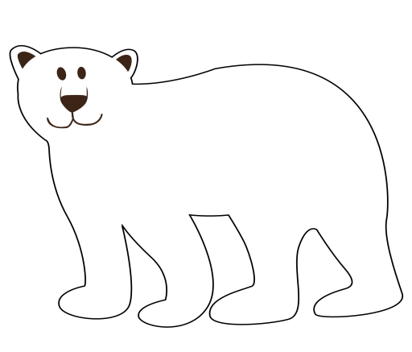
Thermal conduction
Conductors and insulators
Metals are the best thermal conductors. They feel cold to the touch as heat is quickly conducted away from your hand.
Poor conductors are called insulators.
Non-metals tend to be poor conductors. A polystyrene tile feels warm to the touch because it stops your hand from losing thermal energy.

Slide 19
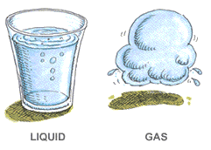
Thermal conduction
Conductors and insulators
Metals are the best thermal conductors. They feel cold to the touch as heat is quickly conducted away from your hand.
Poor conductors are called insulators.
Non-metals tend to be poor conductors. A polystyrene tile feels warm to the touch because it stops your hand from losing thermal energy.
Liquids are poor conductors, and gases are the worst of all. Many insulators have tiny pockets of trapped air.

Slide 20
Thermal conduction
Comparing conductors
Brass
Steel
HEAT
Aluminium
Drawing pin held on with vaseline.
copper

Slide 21
Thermal conduction
Comparing conductors
Brass
Steel
HEAT
Aluminium
Material | Time for pin to fall (secs)
Aluminium | 125
Brass | 189
Copper | 73
Steel | 340
Drawing pin held on with vaseline.
copper

Slide 22
Thermal conduction
Comparing conductors
Brass
Conclusion:
Copper is the best conductor of thermal energy, steel is the worst.
Steel
HEAT
Aluminium
Material | Time for pin to fall (secs)
Aluminium | 125
Brass | 189
Copper | 73
Steel | 340
Drawing pin held on with vaseline.
copper

Slide 23
Thermal conduction
Comparing conductors
Brass
Conclusion:
Copper is the best conductor of thermal energy, steel is the worst.
Steel
HEAT
Aluminium
Material | Time for pin to fall (secs)
Aluminium | 125
Brass | 189
Copper | 73
Steel | 340
Drawing pin held on with vaseline.
copper
Material | Textbook relative conductivity values.
Aluminium | 204
Brass | 109
Copper | 385
Steel | 16

Slide 24
Thermal conduction
Comparing conductors
As the top of the tube is heated, the water boils and turns into steam.
The ice trapped at the bottom of the tube does not melt.
Boiling water
heat
Gauze
Ice

Slide 25
Thermal conduction
Comparing conductors
As the top of the tube is heated, the water boils and turns into steam.
The ice trapped at the bottom of the tube does not melt.
Boiling water
heat
This experiment shows that water is a poor conductor of thermal energy (heat).
Gauze
Ice

Slide 26
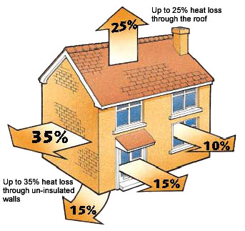
Thermal conduction
Using insulating materials
http://www.tameside.gov.uk/toptips/august

Slide 27
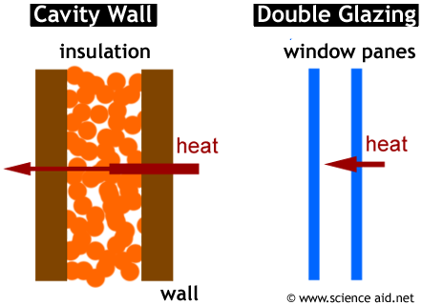
Thermal conduction
Using insulating materials
http://www.tameside.gov.uk/toptips/august
1. Double-glazed windows; two sheets of glass with air between them.
http://www.scienceaid.co.uk/physics/electricity/energy.html
2. Wall cavity filled with plastic foam, beads, or mineral wool.

Slide 28
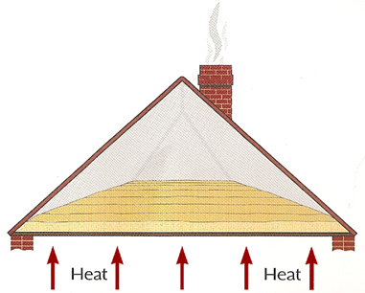
Thermal conduction
Using insulating materials
3. Loft insulation – glass or mineral wool, with air trapped between the fibres.
http://www.bromacbuilders.com/insulation.html
http://www.tameside.gov.uk/toptips/august
1. Double-glazed windows; two sheets of glass with air between them.
http://www.scienceaid.co.uk/physics/electricity/energy.html
2. Wall cavity filled with plastic foam, beads, or mineral wool.

Slide 29
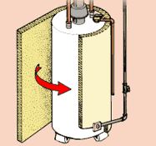
Thermal conduction
Using insulating materials
3. Loft insulation – glass or mineral wool, with air trapped between the fibres.
http://www.bromacbuilders.com/insulation.html
http://www.tameside.gov.uk/toptips/august
1. Double-glazed windows; two sheets of glass with air between them.
4. Plastic foam lagging around the hot water storage tank.
http://www.scienceaid.co.uk/physics/electricity/energy.html
2. Wall cavity filled with plastic foam, beads, or mineral wool.
http://www.proinsulation.co.uk/Tank_&_Pipe_Insulation.html

Slide 30
Thermal conduction
Explaining conduction
In a metal, there are many tiny electrons fixed inside the atoms. Some, however, are ‘loose’ and free to drift between the atoms. If the metal is heated then the free electrons begin to move more quickly (they have more kinetic energy).

Slide 31
Thermal conduction
Explaining conduction
In a metal, there are many tiny electrons fixed inside the atoms. Some, however, are ‘loose’ and free to drift between the atoms. If the metal is heated then the free electrons begin to move more quickly (they have more kinetic energy).
These free electrons are moving randomly within the metal. They may collide with the atoms and make them vibrate more quickly. This means that the thermal energy is transferred rapidly to all parts, making metals good thermal conductors.
Any material that conducts will have particles vibrating and pushing on neighbouring particles. But in metals, this energy transfer through the movement of free electrons means that they conduct energy much more quickly.

Slide 32
LEARNING OBJECTIVES
2.3.1 Conduction Core • Describe experiments to demonstrate the properties of good and bad thermal conductors 2.3.2 Convection Core • Recognise convection as an important method of thermal transfer in fluids • Relate convection in fluids to density changes and describe experiments to illustrate convection 2.3.3 Radiation Core • Identify infra-red radiation as part of the electromagnetic spectrum • Recognise that thermal energy transfer by radiation does not require a medium • Describe the effect of surface colour (black or white) and texture (dull or shiny) on the emission, absorption and reflection of radiation 2.3.4 Consequences of energy transfer Core • Identify and explain some of the everyday applications and consequences of conduction, convection and radiation | Supplement • Give a simple molecular account of conduction in solids including lattice vibration and transfer by electrons Supplement • Describe experiments to show the properties of good and bad emitters and good and bad absorbers of infra-red radiation • Show understanding that the amount of radiation emitted also depends on the surface temperature and surface area of a body

Slide 33
Convection
Convection involves the actual movement of particles to carry thermal energy. Liquids and gases are poor conductors of heat, but because their particles are free to move from place to place so they can transfer thermal energy by convection.

Slide 34
Convection
Convection involves the actual movement of particles to carry thermal energy. Liquids and gases are poor conductors of heat, but because their particles are free to move from place to place so they can transfer thermal energy by convection.
Can we see convection in a liquid?

Slide 35
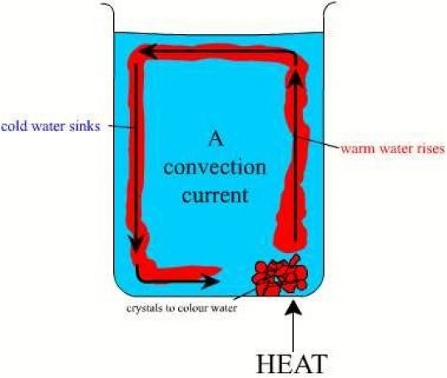
Convection
Convection involves the actual movement of particles to carry thermal energy. Liquids and gases are poor conductors of heat, but because their particles are free to move from place to place so they can transfer thermal energy by convection.
http://thermalphysics.weebly.com/convection.html
Can we see convection in a liquid?
The water above the heat source becomes warmer, expands, and rises as it becomes less dense.

Slide 36
Convection
Convection involves the actual movement of particles to carry thermal energy. Liquids and gases are poor conductors of heat, but because their particles are free to move from place to place so they can transfer thermal energy by convection.
http://thermalphysics.weebly.com/convection.html
Can we see convection in a liquid?
The water above the heat source becomes warmer, expands, and rises as it becomes less dense.
The cooler, more dense water sinks to the bottom of the beaker. It is then heated.

Slide 37
Convection
Convection involves the actual movement of particles to carry thermal energy. Liquids and gases are poor conductors of heat, but because their particles are free to move from place to place so they can transfer thermal energy by convection.
http://thermalphysics.weebly.com/convection.html
Can we see convection in a liquid?
The water above the heat source becomes warmer, expands, and rises as it becomes less dense.
The cooler, more dense water sinks to the bottom of the beaker. It is then heated.
This circulation of warm and cold water sets up a circulating stream, called a convection current.

Slide 38
Convection
Convection in gases

Slide 39
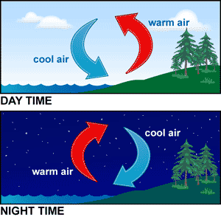
Convection
http://www.pinterest.com/pin/452400725040236330/

Slide 40
Convection
http://www.pinterest.com/pin/452400725040236330/
During daytime, as the Sun shines, land heats up more quickly than the sea. This results in air being warmed and rising. This warmer air is replaced by cooler air coming in from the sea.

Slide 41
Convection
http://www.pinterest.com/pin/452400725040236330/
During daytime, as the Sun shines, land heats up more quickly than the sea. This results in air being warmed and rising. This warmer air is replaced by cooler air coming in from the sea.
The reverse happens during nighttime. The sea remains warmer than the land, which cools down more quickly. Above the sea the warm air rises, and it is replaced by cooler air coming in from the land.

Slide 42
Convection

Slide 43
Convection
Convection in the home

Slide 44
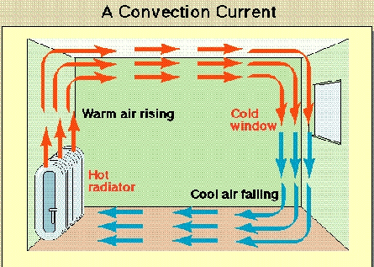
Convection
Convection in the home
As the convector heater gets warmer, it heats air immediately above it.
1
http://imgarcade.com/1/air-convection-currents/

Slide 45
Convection
Convection in the home
As the convector heater gets warmer, it heats air immediately above it.
The warm air rises, carrying thermal energy all around the room.
2
1
http://imgarcade.com/1/air-convection-currents/

Slide 46
Convection
Convection in the home
As the convector heater gets warmer, it heats air immediately above it.
The warm air rises, carrying thermal energy all around the room.
As the air cools, so it falls towards the floor before being heated again.
2
1
3
http://imgarcade.com/1/air-convection-currents/

Slide 47
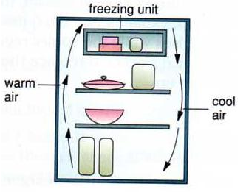
Convection
Convection in the home
http://chowlaiwan-physicsproject2009.blogspot.co.uk/
In the refrigerator, the cool air sinks below the freezer compartment. This sets up a circulating current of air which cools all food in the refrigerator.

Slide 48
LEARNING OBJECTIVES
2.3.1 Conduction Core • Describe experiments to demonstrate the properties of good and bad thermal conductors 2.3.2 Convection Core • Recognise convection as an important method of thermal transfer in fluids • Relate convection in fluids to density changes and describe experiments to illustrate convection 2.3.3 Radiation Core • Identify infra-red radiation as part of the electromagnetic spectrum • Recognise that thermal energy transfer by radiation does not require a medium • Describe the effect of surface colour (black or white) and texture (dull or shiny) on the emission, absorption and reflection of radiation 2.3.4 Consequences of energy transfer Core • Identify and explain some of the everyday applications and consequences of conduction, convection and radiation | Supplement • Give a simple molecular account of conduction in solids including lattice vibration and transfer by electrons Supplement • Describe experiments to show the properties of good and bad emitters and good and bad absorbers of infra-red radiation • Show understanding that the amount of radiation emitted also depends on the surface temperature and surface area of a body

Slide 49
Radiation

Slide 50
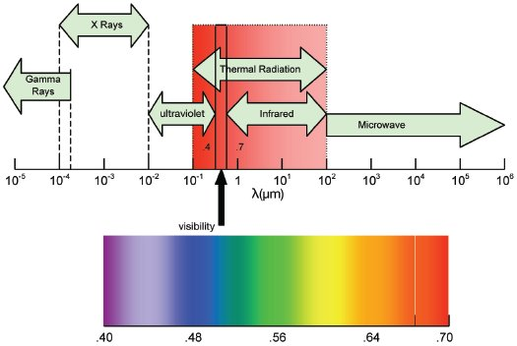
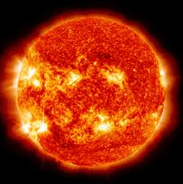
Radiation
http://www.nasatech.com/PTB/features/2009/feat1_0909.html
Energy travels to us from the Sun in the form of electromagnetic radiation. These waves can travel through the vacuum of space.

Slide 51
Radiation
http://www.nasatech.com/PTB/features/2009/feat1_0909.html
Thermal radiation includes the invisible infrared waves as well as visible light.
Energy travels to us from the Sun in the form of electromagnetic radiation. These waves can travel through the vacuum of space.

Slide 52
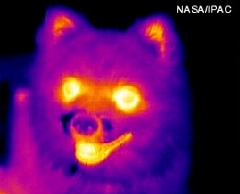
Radiation
http://www.nasatech.com/PTB/features/2009/feat1_0909.html
Thermal radiation includes the invisible infrared waves as well as visible light.
All objects give out some thermal (heat) radiation.
Energy travels to us from the Sun in the form of electromagnetic radiation. These waves can travel through the vacuum of space.

Slide 53
Radiation
http://www.nasatech.com/PTB/features/2009/feat1_0909.html
Thermal radiation includes the invisible infrared waves as well as visible light.
All objects give out some thermal (heat) radiation.
Energy travels to us from the Sun in the form of electromagnetic radiation. These waves can travel through the vacuum of space.
Warm objects give out infrared radiation. As objects become hotter, so they begin to give out shorter wavelengths such as light. This is why hot objects, such as grills, glow as they continue to heat up.

Slide 54
Radiation
Emitters and absorbers

Slide 55
Radiation
Emitters and absorbers
Take in thermal radiation
Give out thermal radiation

Slide 56
Radiation
Emitters and absorbers
Take in thermal radiation
Give out thermal radiation
Good emitters of heat energy are also good absorbers

Slide 57
Radiation
Emitters and absorbers
Take in thermal radiation
Give out thermal radiation
Good emitters of heat energy are also good absorbers
Emitters best worst
Matt black
Matt black
White
Silver
Reflectors worst best
Absorbers best worst

Slide 58
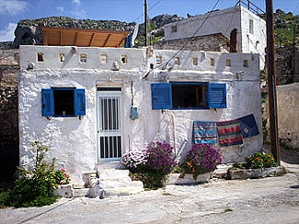
Radiation
Emitters and absorbers
Take in thermal radiation
Give out thermal radiation
Good emitters of heat energy are also good absorbers
Emitters best worst
Matt black
Matt black
White
Silver
Reflectors worst best
In hot, sunny countries, houses are often painted white to reflect heat and keep them cool.
Absorbers best worst

Slide 59
Radiation
Emitters and absorbers
Leslie’s cube
Metal cube filled with very hot water
Thermal radiation detector
Black face
Equal distance
Meter
Silver face
White face

Slide 60
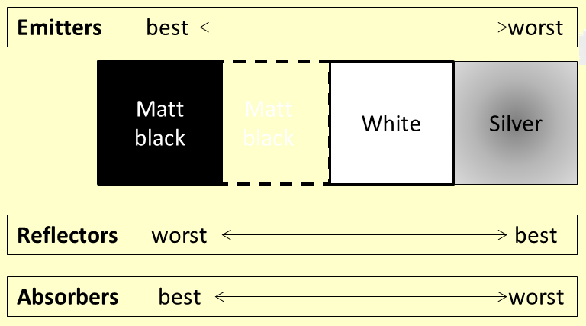
Radiation
Emitters and absorbers
Leslie’s cube
Metal cube filled with very hot water
Thermal radiation detector
Black face
Equal distance
Meter
Silver face
White face
The thermal radiation detector compares the amount of heat energy emitted from the different faces.

Slide 61
Radiation
Emitters and absorbers
Thermometer
Matt black surface
Silver surface
Radiant heater

Slide 62
Radiation
Emitters and absorbers
Thermometer
Thermometers are attached to the rear of metal plates which are placed at equal distances from the radiant heater. Thermal energy from the radiant heater is absorbed by the two plates, and the thermometers help us to assess which colour is the best absorber.
Matt black surface
Silver surface
Radiant heater

Slide 63
Radiation
Thermal Radiation and the Greenhouse Effect.

Slide 64
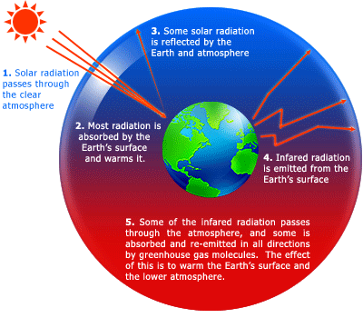
Radiation
Thermal Radiation and the Greenhouse Effect.

Slide 65
Radiation
Thermal Radiation and the Greenhouse Effect.

Slide 66
Radiation
Thermal Radiation and the Greenhouse Effect.
Without this absorbing of the solar radiation and the heat-trapping of the atmosphere the Earth’s surface would be about 25ºC cooler than it is.

Slide 67
Radiation
Thermal Radiation and the Greenhouse Effect.

Slide 68
Radiation
Thermal Radiation and the Greenhouse Effect.

Slide 69
Radiation
Thermal Radiation and the Greenhouse Effect.
However, additional carbon dioxide from the combustion of fuels may be adding to this effect and causing global warming.

Slide 70
Radiation
Thermal Radiation and the Greenhouse Effect.
In a greenhouse the Sun’s thermal energy passes through the glass panels, warms the ground inside and heats the air, but the hot air then becomes trapped.
However, additional carbon dioxide from the combustion of fuels may be adding to this effect and causing global warming.

Slide 71
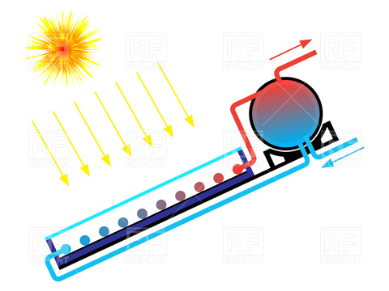
Radiation
Thermal Radiation and the Greenhouse Effect.
In a greenhouse the Sun’s thermal energy passes through the glass panels, warms the ground inside and heats the air, but the hot air then becomes trapped.
Solar panels use the Sun’s thermal radiation to warm up water for the house. A blackened layer behind the pipes absorbs the radiant energy, heating the water in the pipes.
http://imgarcade.com/1/heater-clip-art/
However, additional carbon dioxide from the combustion of fuels may be adding to this effect and causing global warming.

Slide 72
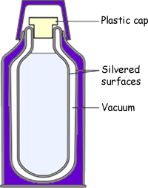
Radiation
Thermal Radiation and the Greenhouse Effect.
In a greenhouse the Sun’s thermal energy passes through the glass panels, warms the ground inside and heats the air, but the hot air then becomes trapped.
Solar panels use the Sun’s thermal radiation to warm up water for the house. A blackened layer behind the pipes absorbs the radiant energy, heating the water in the pipes.
http://imgarcade.com/1/heater-clip-art/
Plastic cap (stopper) reduces conduction and convection.
Vacuum in the gap reduces conduction and convection.
Walls with silvery surfaces reduce thermal radiation.
However, additional carbon dioxide from the combustion of fuels may be adding to this effect and causing global warming.
http://www.cyberphysics.co.uk/Q&A/KS4/heat/A5.html

Slide 73
LEARNING OBJECTIVES
2.3.1 Conduction Core • Describe experiments to demonstrate the properties of good and bad thermal conductors 2.3.2 Convection Core • Recognise convection as an important method of thermal transfer in fluids • Relate convection in fluids to density changes and describe experiments to illustrate convection 2.3.3 Radiation Core • Identify infra-red radiation as part of the electromagnetic spectrum • Recognise that thermal energy transfer by radiation does not require a medium • Describe the effect of surface colour (black or white) and texture (dull or shiny) on the emission, absorption and reflection of radiation 2.3.4 Consequences of energy transfer Core • Identify and explain some of the everyday applications and consequences of conduction, convection and radiation | Supplement • Give a simple molecular account of conduction in solids including lattice vibration and transfer by electrons Supplement • Describe experiments to show the properties of good and bad emitters and good and bad absorbers of infra-red radiation • Show understanding that the amount of radiation emitted also depends on the surface temperature and surface area of a body

Slide 74
PHYSICS – Thermal processes

