Slide 1
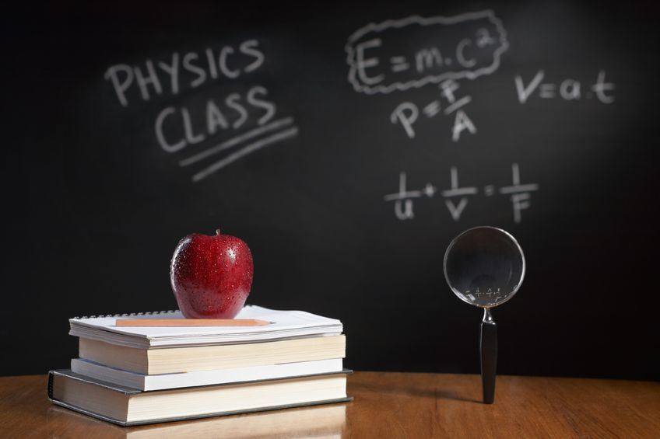
PHYSICS – Thermal properties and temperature (2).

Slide 2
LEARNING OBJECTIVES
2.2.3 Thermal capacity (heat capacity) Core • Relate a rise in the temperature of a body to an increase in its internal energy • Show an understanding of what is meant by the thermal capacity of a body 2.2.4 Melting and boiling Core • Describe melting and boiling in terms of energy input without a change in temperature • State the meaning of melting point and boiling point • Describe condensation and solidification in terms of molecules | Supplement • Give a simple molecular account of an increase in internal energy • Recall and use the equation thermal capacity = mc • Define specific heat capacity • Describe an experiment to measure the specific heat capacity of a substance • Recall and use the equation change in energy = mc∆T Supplement • Distinguish between boiling and evaporation • Use the terms latent heat of vaporisation and latent heat of fusion and give a molecular interpretation of latent heat • Define specific latent heat • Describe an experiment to measure specific latent heats for steam and for ice • Recall and use the equation energy = ml

Slide 3
Thermal (heat) capacity
What requires more energy to heat up by 1ºC?

Slide 4
Thermal (heat) capacity
What requires more energy to heat up by 1ºC?
1 kg water

Slide 5
Thermal (heat) capacity
What requires more energy to heat up by 1ºC?
1 kg water
1 kg aluminium

Slide 6
Thermal (heat) capacity
What requires more energy to heat up by 1ºC?
1 kg water
1 kg aluminium
4200 joules of energy
900 joules of energy

Slide 7
Thermal (heat) capacity
What requires more energy to heat up by 1ºC?
1 kg water
Water must be supplied with nearly five times as much energy as aluminium for the same rise in temperature.
1 kg aluminium
4200 joules of energy
900 joules of energy

Slide 8
Thermal (heat) capacity
What requires more energy to heat up by 1ºC?
It’s all to do with the SPECIFIC HEAT CAPACITY of the material
1 kg water
Water must be supplied with nearly five times as much energy as aluminium for the same rise in temperature.
1 kg aluminium
4200 joules of energy
900 joules of energy

Slide 9
Thermal (heat) capacity
The specific heat capacity of a substance is the amount of energy needed to change the temperature of 1kg of the substance by 1ºC.

Slide 10
Thermal (heat) capacity
The specific heat capacity of a substance is the amount of energy needed to change the temperature of 1kg of the substance by 1ºC.
Substance | SHC (J / kg ºC)
Water | 4181
Oxygen | 918
Lead | 128

Slide 11
Thermal (heat) capacity
The specific heat capacity of a substance is the amount of energy needed to change the temperature of 1kg of the substance by 1ºC.
Water has a particularly high SHC, making it very useful for storing heat energy, and for transporting it, eg. in central heating
Substance | SHC (J / kg ºC)
Water | 4181
Oxygen | 918
Lead | 128

Slide 12
Thermal (heat) capacity
The equation
(just what you wanted!)

Slide 13
Thermal (heat) capacity
The equation
(just what you wanted!)
Energy transferred = mass x specific heat capacity x temperature
Energy transferred = m c ΔT
Where: m is the mass in kg,
c is the SHC in J/(kgºC)
ΔT is the temperature change in ºC (or in K)

Slide 14
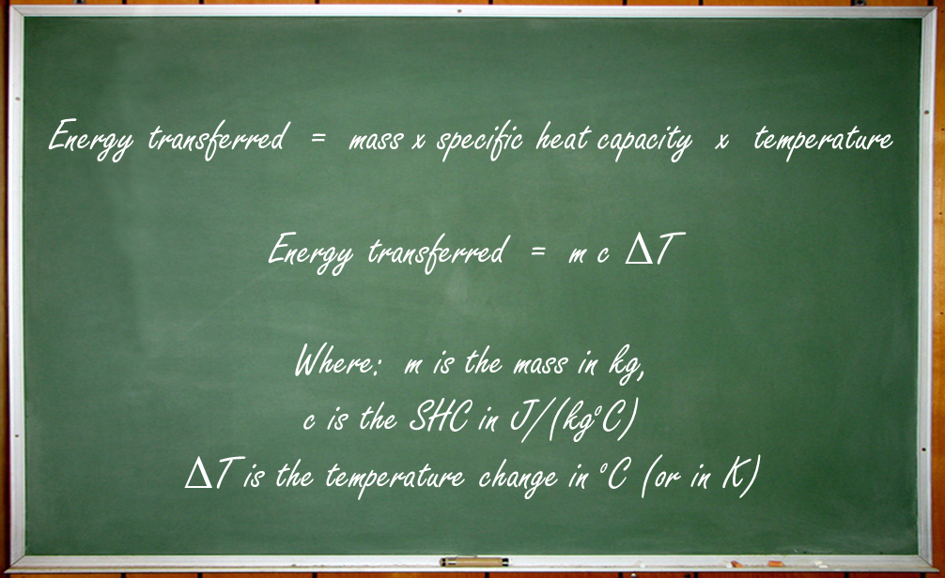
Thermal (heat) capacity
The equation
(just what you wanted!)
How much energy needs to be transferred to raise the temperature of 2kg of water from 20ºC to 30ºC?

Slide 15
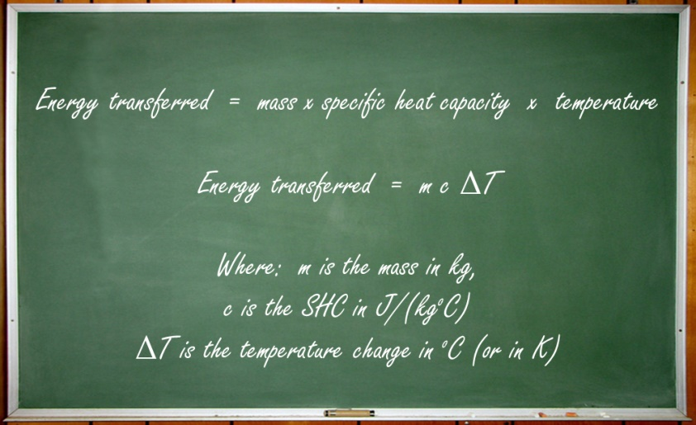
Thermal (heat) capacity
The equation
(just what you wanted!)
How much energy needs to be transferred to raise the temperature of 2kg of water from 20ºC to 30ºC?
Energy transferred = mass x SHC x temp. change
= 2 x 4181 x (30 – 20)
= 2 x 4181 x 10
= 83,620 J = 83.62 kJ

Slide 16
Thermal (heat) capacity
So what’s this ‘thermal capacity’ bit?

Slide 17
Thermal (heat) capacity
So what’s this ‘thermal capacity’ bit?
Thermal capacity = mass x SHC

Slide 18
Thermal (heat) capacity
So what’s this ‘thermal capacity’ bit?
Thermal capacity = mass x SHC
eg. If there is 3kg of water in a kettle:
Thermal capacity = 3 x 4181
= 12,543 J/ºC

Slide 19
Thermal (heat) capacity
So what’s this ‘thermal capacity’ bit?
Thermal capacity = mass x SHC
This means that for every 1ºC rise in temperature of the water in the kettle, 12,543 J of energy need to be supplied.
eg. If there is 3kg of water in a kettle:
Thermal capacity = 3 x 4181
= 12,543 J/ºC

Slide 20
Measuring specific heat capacity

Slide 21
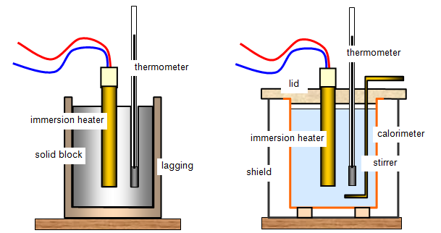
Measuring specific heat capacity
Energy = power x time
Apparatus for determining the SHC of a solid, eg. Aluminium
Apparatus for determining the SHC of a liquid, eg. Water
http://www.schoolphysics.co.uk/age16-19/Thermal%20physics/Heat%20energy/text/Specific_heat_capacity_measurement/index.html

Slide 22
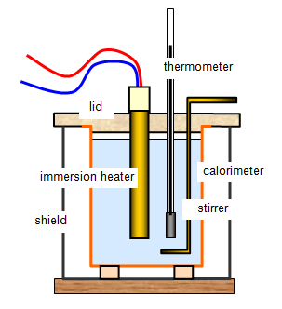
Measuring specific heat capacity
Energy = power x time
Beaker contains 0.75 kg of water.
Immersion heater (200W) switched on for 200 seconds
Temperature of the water rises by 12.5ºC
Calculate the SHC of water
Apparatus for determining the SHC of a liquid, eg. Water
http://www.schoolphysics.co.uk/age16-19/Thermal%20physics/Heat%20energy/text/Specific_heat_capacity_measurement/index.html

Slide 23
Measuring specific heat capacity
Energy = power x time
Beaker contains 0.75 kg of water.
Immersion heater (200W) switched on for 200 seconds
Temperature of the water rises by 12.5ºC
Calculate the SHC of water
Apparatus for determining the SHC of a liquid, eg. Water
Energy transferred = power x time
= 200 x 200 = 40,000J
= 0.75 x c x 12.5
c = 40 000 / (0.75 x 12.5)
SHC of water = 4267 J(kgºC)
http://www.schoolphysics.co.uk/age16-19/Thermal%20physics/Heat%20energy/text/Specific_heat_capacity_measurement/index.html

Slide 24
Measuring specific heat capacity
Energy = power x time
Beaker contains 0.75 kg of water.
Immersion heater (200W) switched on for 200 seconds
Temperature of the water rises by 12.5ºC
Calculate the SHC of water
Apparatus for determining the SHC of a liquid, eg. Water
Energy transferred = power x time
= 200 x 200 = 40,000J
= 0.75 x c x 12.5
c = 40 000 / (0.75 x 12.5)
SHC of water = 4267 J(kgºC)
http://www.schoolphysics.co.uk/age16-19/Thermal%20physics/Heat%20energy/text/Specific_heat_capacity_measurement/index.html
Actual value for the SHC of water is 4181 J / kgºC. The method described does not make any allowance for heat loss to the surroundings or the beaker.

Slide 25
Thermal (heat) capacity
Using the high SHC of water:
Central heating system, water carries thermal energy from the boiler to the radiators.
Radiator
M
Pump
Boiler

Slide 26
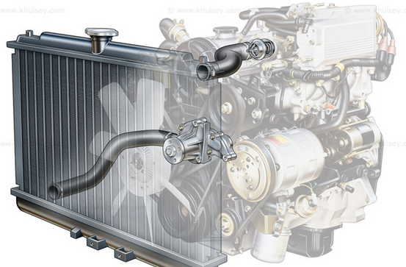
Thermal (heat) capacity
Using the high SHC of water:
Central heating system, water carries thermal energy from the boiler to the radiators.
In car cooling systems, water carries unwanted heat energy from the engine to the radiator.
Radiator
M
Pump
Boiler

Slide 27
LEARNING OBJECTIVES
2.2.3 Thermal capacity (heat capacity) Core • Relate a rise in the temperature of a body to an increase in its internal energy • Show an understanding of what is meant by the thermal capacity of a body 2.2.4 Melting and boiling Core • Describe melting and boiling in terms of energy input without a change in temperature • State the meaning of melting point and boiling point • Describe condensation and solidification in terms of molecules | Supplement • Give a simple molecular account of an increase in internal energy • Recall and use the equation thermal capacity = mc • Define specific heat capacity • Describe an experiment to measure the specific heat capacity of a substance • Recall and use the equation change in energy = mc∆T Supplement • Distinguish between boiling and evaporation • Use the terms latent heat of vaporisation and latent heat of fusion and give a molecular interpretation of latent heat • Define specific latent heat • Describe an experiment to measure specific latent heats for steam and for ice • Recall and use the equation energy = ml

Slide 28
Latent Heat

Slide 29
Latent Heat
Gas
{
}
Boiling
(evaporating)
condensing
Liquid
{
}
melting
freezing
Solid

Slide 30
Latent Heat
Water has three phases or states:
Solid (ice)
Liquid
Gas (steam, water vapour)
Gas
{
}
Boiling
(evaporating)
condensing
Liquid
{
}
melting
freezing
Solid

Slide 31
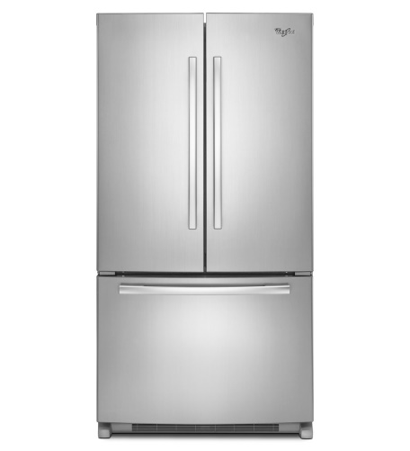
Latent Heat
Thermal energy

Slide 32
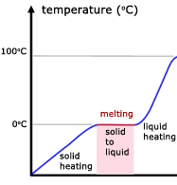
Latent Heat
Thermal energy
Time

Slide 33
Latent Heat
Thermal energy
At this point the ice continues to absorb energy, but it’s temperature does not change.
Time

Slide 34
Latent Heat
Thermal energy
At this point the ice continues to absorb energy, but it’s temperature does not change.
The energy absorbed at this point is called the latent heat of fusion
- It is needed to separate the particles so they can form a liquid.
Time

Slide 35
Latent Heat
Thermal energy
At this point the ice continues to absorb energy, but it’s temperature does not change.
The energy absorbed at this point is called the latent heat of fusion
- It is needed to separate the particles so they can form a liquid.
The energy is released again when a liquid changes back to a solid.
Time

Slide 36
Latent Heat
The specific latent heat of fusion of ice is 330 000 J/kg

Slide 37
Latent Heat
The specific latent heat of fusion of ice is 330 000 J/kg
This means that 330 000 joules of energy are transferred to change each kilogram of ice into water at the same temperature (0ºC).

Slide 38
Latent Heat
The specific latent heat of fusion of ice is 330 000 J/kg
This means that 330 000 joules of energy are transferred to change each kilogram of ice into water at the same temperature (0ºC).
Equation:
Energy transferred = mass x specific latent heat
E = mL

Slide 39
Latent Heat
eg. If 3.5 kg of ice is melted (at 0ºC)
E = mL
Energy transferred = 3.5 x 330 000
E = 1 155 000 J
The specific latent heat of fusion of ice is 330 000 J/kg
This means that 330 000 joules of energy are transferred to change each kilogram of ice into water at the same temperature (0ºC).
Equation:
Energy transferred = mass x specific latent heat
E = mL

Slide 40
Latent Heat
Measuring the specific latent heat of fusion of ice.

Slide 41
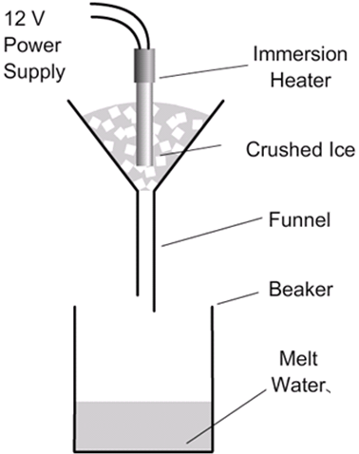
Latent Heat
Measuring the specific latent heat of fusion of ice.

Slide 42
Latent Heat
Power = energy / time
So, energy = Power x time
Measuring the specific latent heat of fusion of ice.
100 W immersion heater switched on for 300 seconds.
Mass of water collected = 0.10kg
E = mL L = E / m
E = 100 x 300 = 30 000 J
L = 30 000 / 0.10 = 300 000 J/kg

Slide 43
Latent Heat
Power = energy / time
So, energy = Power x time
Measuring the specific latent heat of fusion of ice.
100 W immersion heater switched on for 300 seconds.
Mass of water collected = 0.10kg
E = mL L = E / m
E = 100 x 300 = 30 000 J
L = 30 000 / 0.10 = 300 000 J/kg
Only an approximate figure for L as no allowance made for heat loss to the surroundings.

Slide 44
Latent Heat of Fusion
Power = energy / time
So, energy = Power x time
Measuring the specific latent heat of fusion of ice.
100 W immersion heater switched on for 300 seconds.
Mass of water collected = 0.10kg
E = mL L = E / m
E = 100 x 300 = 30 000 J
L = 30 000 / 0.10 = 300 000 J/kg
Only an approximate figure for L as no allowance made for heat loss to the surroundings.

Slide 45
Latent Heat of Vaporization

Slide 46
Latent Heat of Vaporization
Water boils at 100ºC, producing steam.

Slide 47
Latent Heat of Vaporization
Water boils at 100ºC, producing steam.
If the kettle is not switched off, more thermal energy is absorbed by the water, producing more steam at 100ºC.

Slide 48
Latent Heat of Vaporization
Water boils at 100ºC, producing steam.
If the kettle is not switched off, more thermal energy is absorbed by the water, producing more steam at 100ºC.
The energy absorbed by the water is called the latent heat of vaporization

Slide 49
Latent Heat of Vaporization
Water boils at 100ºC, producing steam.
If the kettle is not switched off, more thermal energy is absorbed by the water, producing more steam at 100ºC.
The energy absorbed by the water is called the latent heat of vaporization
Most of the thermal energy is need to separate the particles so they can form a gas. Some energy is required to push back the atmosphere as the gas forms.

Slide 50
Latent Heat of Vaporization
The specific latent heat of vaporization of water is 2 300 000 J/kg

Slide 51
Latent Heat of Vaporization
The specific latent heat of vaporization of water is 2 300 000 J/kg
This means that 2 300 000 joules of energy are transferred to change each kilogram of liquid water into steam at the same temperature (100ºC).

Slide 52
Latent Heat of Vaporization
The specific latent heat of vaporization of water is 2 300 000 J/kg
Same equation as for the specific latent heat of fusion:
E = mL
But this time ‘L’ is the specific latent heat of vaporization.
This means that 2 300 000 joules of energy are transferred to change each kilogram of liquid water into steam at the same temperature (100ºC).

Slide 53
Latent Heat of Vaporization
Measuring the specific latent heat of vaporization of water.

Slide 54
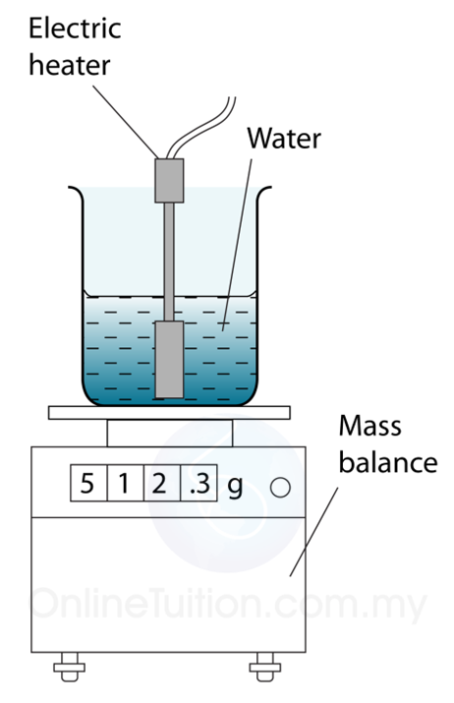
Latent Heat of Vaporization
Measuring the specific latent heat of vaporization of water.
http://spmphysics.onlinetuition.com.my/2013/07/measuring-specific-latent-heat-of_6.html

Slide 55
Latent Heat of Vaporization
Power = energy / time
So, energy = Power x time
Measuring the specific latent heat of vaporization of water.
100 W immersion heater switched on for 500 seconds.
Mass of water boiled away = 20.0g
E = mL L = E / m
E = 100 x 500 = 50 000 J
L = 50 000 / 0.02 = 2 500 000 J/kg
http://spmphysics.onlinetuition.com.my/2013/07/measuring-specific-latent-heat-of_6.html

Slide 56
Latent Heat of Vaporization
Power = energy / time
So, energy = Power x time
Measuring the specific latent heat of vaporization of water.
100 W immersion heater switched on for 500 seconds.
Mass of water boiled away = 20.0g
E = mL L = E / m
E = 100 x 500 = 50 000 J
L = 50 000 / 0.02 = 2 500 000 J/kg
http://spmphysics.onlinetuition.com.my/2013/07/measuring-specific-latent-heat-of_6.html
Only an approximate figure for L as no allowance made for heat loss to the surroundings.

Slide 57
LEARNING OBJECTIVES
2.2.3 Thermal capacity (heat capacity) Core • Relate a rise in the temperature of a body to an increase in its internal energy • Show an understanding of what is meant by the thermal capacity of a body 2.2.4 Melting and boiling Core • Describe melting and boiling in terms of energy input without a change in temperature • State the meaning of melting point and boiling point • Describe condensation and solidification in terms of molecules | Supplement • Give a simple molecular account of an increase in internal energy • Recall and use the equation thermal capacity = mc • Define specific heat capacity • Describe an experiment to measure the specific heat capacity of a substance • Recall and use the equation change in energy = mc∆T Supplement • Distinguish between boiling and evaporation • Use the terms latent heat of vaporisation and latent heat of fusion and give a molecular interpretation of latent heat • Define specific latent heat • Describe an experiment to measure specific latent heats for steam and for ice • Recall and use the equation energy = ml

Slide 58
PHYSICS – Thermal properties and temperature (2).

