Slide 1
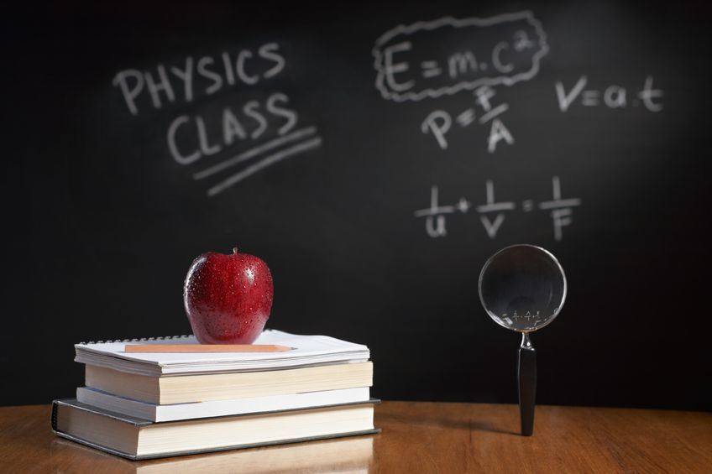
PHYSICS – Simple kinetic molecular model of matter (2)

Slide 2
LEARNING OBJECTIVES
2.1.3 Evaporation Core • Describe evaporation in terms of the escape of more-energetic molecules from the surface of a liquid • Relate evaporation to the consequent cooling of the liquid 2.1.4 Pressure changes Core • Describe qualitatively, in terms of molecules, the effect on the pressure of a gas of: – a change of temperature at constant volume – a change of volume at constant temperature | Supplement • Demonstrate an understanding of how temperature, surface area and draught over a surface influence evaporation • Explain the cooling of a body in contact with an evaporating liquid Supplement • Recall and use the equation pV = constant for a fixed mass of gas at constant temperature

Slide 3
LEARNING OBJECTIVES
2.1.3 Evaporation Core • Describe evaporation in terms of the escape of more-energetic molecules from the surface of a liquid • Relate evaporation to the consequent cooling of the liquid 2.1.4 Pressure changes Core • Describe qualitatively, in terms of molecules, the effect on the pressure of a gas of: – a change of temperature at constant volume – a change of volume at constant temperature | Supplement • Demonstrate an understanding of how temperature, surface area and draught over a surface influence evaporation • Explain the cooling of a body in contact with an evaporating liquid Supplement • Recall and use the equation pV = constant for a fixed mass of gas at constant temperature

Slide 4
Evaporation
Previously: ………
What do we know so far about the properties of liquids and evaporation?

Slide 5
Evaporation
Previously: ………
What do we know so far about the properties of liquids and evaporation?

Slide 6
Evaporation
Previously: ………
What do we know so far about the properties of liquids and evaporation?

Slide 7
Evaporation
Previously: ………
What do we know so far about the properties of liquids and evaporation?

Slide 8
Evaporation
When a liquid evaporates, faster particles escape from its surface to form a gas. However, unless the gas is removed, some of the particles will return to the liquid.
GAS
LIQUID

Slide 9
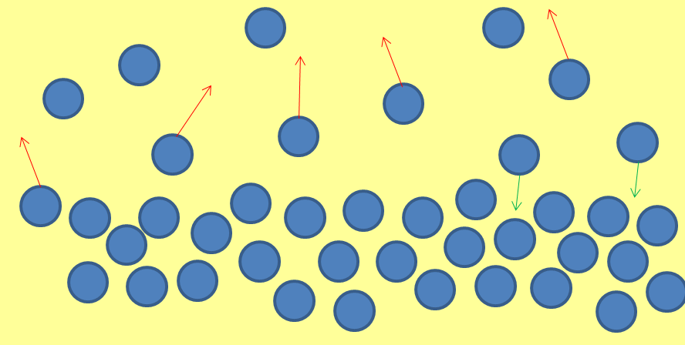
Evaporation
How can we increase the rate of evaporation?
Increase the temperature.
Wet clothes will dry faster on a hot day because more of the water molecules have sufficient energy to escape from the surface of the liquid.
HEAT

Slide 10
Evaporation
How can we increase the rate of evaporation?
2. Increase the surface area.
If the surface area is increased (eg. pour a hot drink from a cup into the saucer) then more of the molecules are closer to the surface of the liquid..

Slide 11
Evaporation
How can we increase the rate of evaporation?
H₂O
H₂O
H₂O
H₂O
H₂O
H₂O
3. Reduce the humidity.
Air can be very humid, which means that it will have a high water vapour content. In humid air, less water will evaporate, whereas in air with low humidity the rate of evaporation will be faster.

Slide 12
Evaporation
Blow air across the surface
Wet clothes will dry faster on a windy day because the moving air carries escaping water molecules away before many of them can return to the liquid.
How can we increase the rate of evaporation?

Slide 13
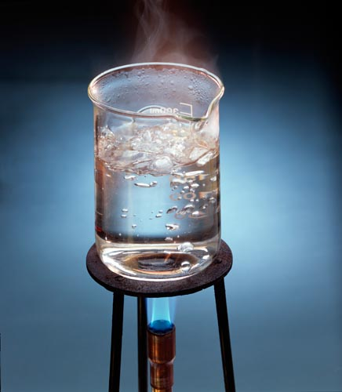
Evaporation
So what’s the difference between evaporation and boiling?
Boiling is a very rapid form of evaporation
Vapour bubbles form in the liquid and as they rise and burst at the surface they release large amounts of vapour.
http://www.fphoto.com/

Slide 14
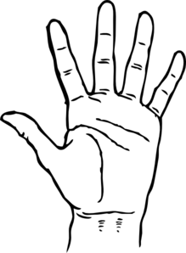
Evaporation and Cooling
If your hands are wet then water will start to evaporate from the surface.
H₂O
H₂O
H₂O

Slide 15
Evaporation and Cooling
If your hands are wet then water will start to evaporate from the surface.
H₂O
H₂O
H₂O
Your skin feels cooler as the evaporating water takes thermal energy away.

Slide 16
Evaporation and Cooling
If your hands are wet then water will start to evaporate from the surface.
H₂O
Kinetic theory:
- Faster particles are escaping, so the ones left behind are slower and so have less energy – liquid temperature is therefore less than before.
H₂O
H₂O
Your skin feels cooler as the evaporating water takes thermal energy away.

Slide 17
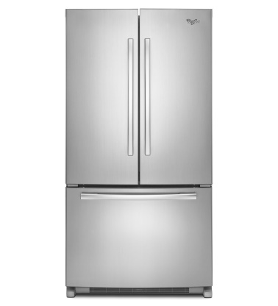
Evaporation and Cooling
The cooling effect of evaporation is put to good use in a refrigerator

Slide 18
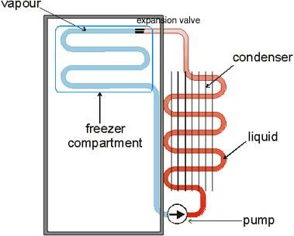
Evaporation and Cooling
The cooling effect of evaporation is put to good use in a refrigerator
1. A liquid called a refrigerant passes through pipes in the freezer compartment. As it evaporates it takes thermal energy from the food and air.
http://www.jland.org/swat/e5/refrig.html

Slide 19
Evaporation and Cooling
The cooling effect of evaporation is put to good use in a refrigerator
1. A liquid called a refrigerant passes through pipes in the freezer compartment. As it evaporates it takes thermal energy from the food and air.
2. The pump draws the vapour away, compresses it and turns it back into a liquid. This releases thermal energy, so the liquid heats up.
http://www.jland.org/swat/e5/refrig.html

Slide 20
Evaporation and Cooling
The cooling effect of evaporation is put to good use in a refrigerator
1. A liquid called a refrigerant passes through pipes in the freezer compartment. As it evaporates it takes thermal energy from the food and air.
2. The pump draws the vapour away, compresses it and turns it back into a liquid. This releases thermal energy, so the liquid heats up.
3. The hot liquid is cooled as it passes through the condenser pipes at the back. The thermal energy is then taken away by the air.
http://www.jland.org/swat/e5/refrig.html

Slide 21
Evaporation and Cooling
The cooling effect of evaporation is put to good use in a refrigerator
1. A liquid called a refrigerant passes through pipes in the freezer compartment. As it evaporates it takes thermal energy from the food and air.
2. The pump draws the vapour away, compresses it and turns it back into a liquid. This releases thermal energy, so the liquid heats up.
3. The hot liquid is cooled as it passes through the condenser pipes at the back. The thermal energy is then taken away by the air.
Overall, the thermal energy is transferred from the food inside the fridge to the air outside.
http://www.jland.org/swat/e5/refrig.html

Slide 22
Evaporation and Cooling
The cooling effect of evaporation is put to good use to help us cool down.
When our body temperature starts to increase more than 0.5ºC above normal we start to sweat – tiny pores in our skin release sweat (mostly water). The liquid evaporates from the skin surface, taking thermal energy with it. This cools us down.
Heat loss through sweating is more difficult when we are in a humid environment.

Slide 23
Changes of State
Gas
{
}
Boiling
(evaporating)
condensing
Liquid
{
}
melting
freezing
Solid

Slide 24
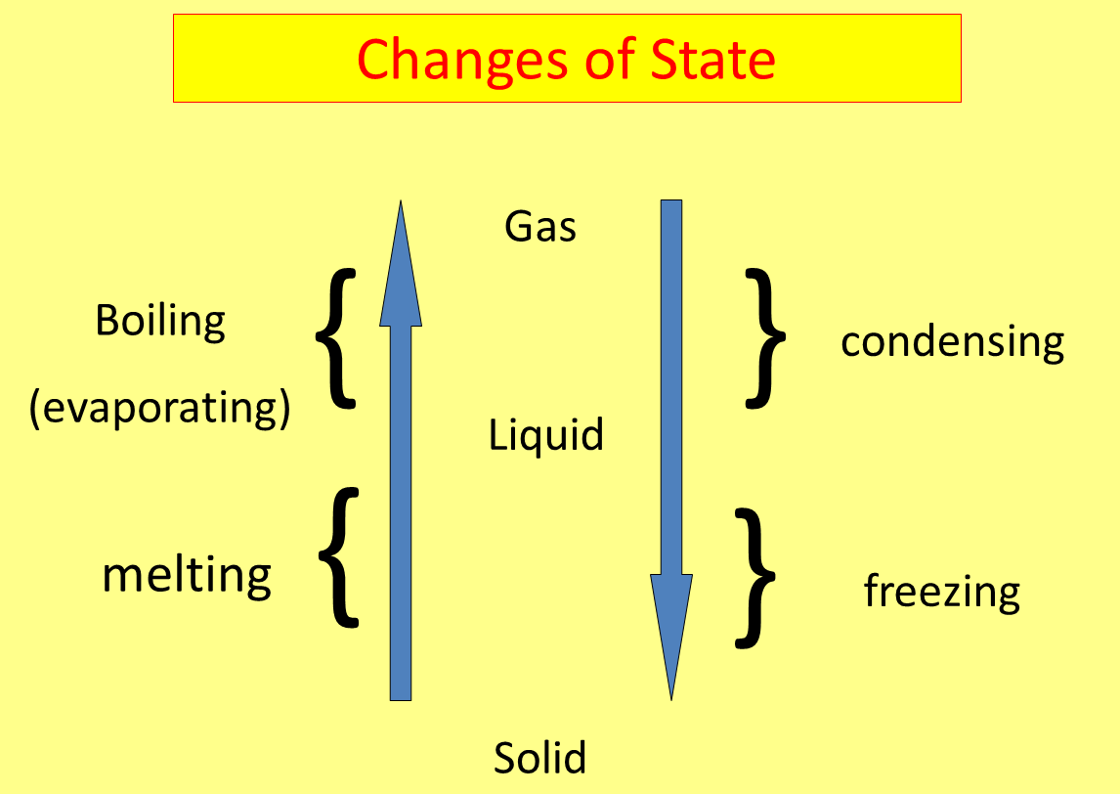
Condensation
Gas changing back into a liquid.
Cold air can hold less water vapour than warm air, so some water vapour may condense if humid air is suddenly cooled.
These tiny water droplets in the air may be seen as fog, mist or clouds.
We might also see condensation on a mirror in a bathroom, or other window surface.

Slide 25
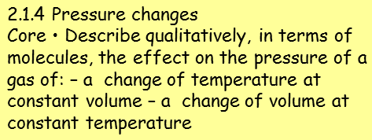
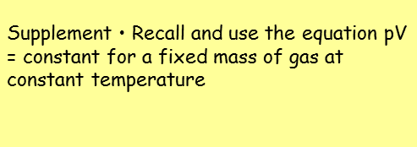
Pressure changes

Slide 26
Gases and Pressure
Kinetic theory tells us that gases consist of very small particles that are constantly moving in completely random directions.
The particles have mass, so whenever they collide with something they exert a force on it. In sealed containers, gas particles will smash against the walls of the container – creating an outward pressure.
If the same amount of gas is put into a bigger container, there will be fewer collisions with the walls of the container, so the pressure will decrease.
If a smaller container is used then there will be more collisions with the walls as the particles are being squashed closer together. The pressure will increase.

Slide 27
Pressure changes – and temperature
(at a constant volume)

Slide 28
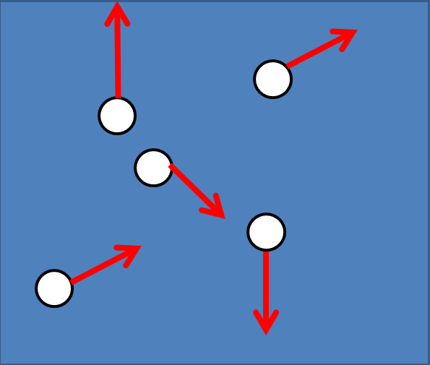
Pressure changes – and temperature
(at a constant volume)
Increasing the temperature of a gas increases the pressure.
If a gas is heated, the particles move faster and have more kinetic energy. As the KE increases, the particles hit the container walls harder and more often, resulting in more pressure.

Slide 29
Pressure changes – and temperature
(at a constant volume)
Increasing the temperature of a gas increases the pressure.
If a gas is heated, the particles move faster and have more kinetic energy. As the KE increases, the particles hit the container walls harder and more often, resulting in more pressure.
Pressure is directly proportional to absolute temperature (in K). Doubling the temperature produces a doubling in pressure.

Slide 30
Pressure changes – and temperature
(at a constant volume)
Increasing the temperature of a gas increases the pressure.
In a sealed container (constant volume:
pressure = constant
temperature
P = constant
T
P₁ = P₂
T₁ T₂
If a gas is heated, the particles move faster and have more kinetic energy. As the KE increases, the particles hit the container walls harder and more often, resulting in more pressure.
Pressure is directly proportional to absolute temperature (in K). Doubling the temperature produces a doubling in pressure.

Slide 31
Pressure changes – and temperature
(at a constant volume)
Increasing the temperature of a gas increases the pressure.
Eg. A sealed container has a volume of 25 litres. The gas inside is at a pressure of 1 bar (1 atm) and a temperature of 300K. What will the pressure be if the temperature is increased to 325K?
Answer: P₁ = P₂
T₁ T₂
1 / 300 = P₂ / 325
P₂ = 325 / 300 = 1.08 bar
If a gas is heated, the particles move faster and have more kinetic energy. As the KE increases, the particles hit the container walls harder and more often, resulting in more pressure.
Pressure is directly proportional to absolute temperature (in K). Doubling the temperature produces a doubling in pressure.

Slide 32
Pressure changes – and volume
(at a constant temperature)

Slide 33
Pressure changes – and volume
(at a constant temperature)
Decreasing the volume of a gas increases the pressure.
The particles have mass, so whenever they collide with something they exert a force on it. In sealed containers, gas particles will smash against the walls of the container – creating an outward pressure.

Slide 34
Pressure changes – and volume
(at a constant temperature)
Decreasing the volume of a gas increases the pressure.
So long as the temperature is kept constant, if the container is made bigger (with the same amount of gas) the pressure will decrease as there are fewer collisions between the particles and the walls of the container (and vice versa).
The particles have mass, so whenever they collide with something they exert a force on it. In sealed containers, gas particles will smash against the walls of the container – creating an outward pressure.

Slide 35
Pressure changes – and volume
(at a constant temperature)
Decreasing the volume of a gas increases the pressure.
So long as the temperature is kept constant, if the container is made bigger (with the same amount of gas) the pressure will decrease as there are fewer collisions between the particles and the walls of the container (and vice versa).
Volume is inversely proportional to pressure. Halving the volume produces a doubling in pressure.
The particles have mass, so whenever they collide with something they exert a force on it. In sealed containers, gas particles will smash against the walls of the container – creating an outward pressure.

Slide 36
Pressure changes – and volume
(at a constant temperature)
Decreasing the volume of a gas increases the pressure.
At constant temperature,
pressure x volume = constant
P x V = constant
P₁ x V₁ = P₂ x V₂
So long as the temperature is kept constant, if the container is made bigger (with the same amount of gas) the pressure will decrease as there are fewer collisions between the particles and the walls of the container (and vice versa).
Volume is inversely proportional to pressure. Halving the volume produces a doubling in pressure.

Slide 37
Pressure changes – and volume
(at a constant temperature)
Decreasing the volume of a gas increases the pressure.
Eg. A gas a constant temperature in a 100 ml container has a pressure of 1.2 atmosphere (atm). What is the new pressure if the container volume is reduced to 60ml?
Answer: P₁ x V₁ = P₂ x V₂
1.2 x 100 = P₂ x 60
1.2 x 100 = P₂ = 2.0atm
60
So long as the temperature is kept constant, if the container is made bigger (with the same amount of gas) the pressure will decrease as there are fewer collisions between the particles and the walls of the container (and vice versa).
Volume is inversely proportional to pressure. Halving the volume produces a doubling in pressure.

Slide 38
LEARNING OBJECTIVES
2.1.3 Evaporation Core • Describe evaporation in terms of the escape of more-energetic molecules from the surface of a liquid • Relate evaporation to the consequent cooling of the liquid 2.1.4 Pressure changes Core • Describe qualitatively, in terms of molecules, the effect on the pressure of a gas of: – a change of temperature at constant volume – a change of volume at constant temperature | Supplement • Demonstrate an understanding of how temperature, surface area and draught over a surface influence evaporation • Explain the cooling of a body in contact with an evaporating liquid Supplement • Recall and use the equation pV = constant for a fixed mass of gas at constant temperature

Slide 39
PHYSICS – Simple kinetic molecular model of matter (2).

